Slide 1

Project Proposal Head and Neck Cancer
Tobias Hub, Nils Mechtel,
Pascal Poc, Niklas Urbanek
https://www.benzinga.com/analyst-ratings/analyst-color/12/11/3071761/seattle-genetics-falls-after-q3-results-and-analyst-down

Slide 2


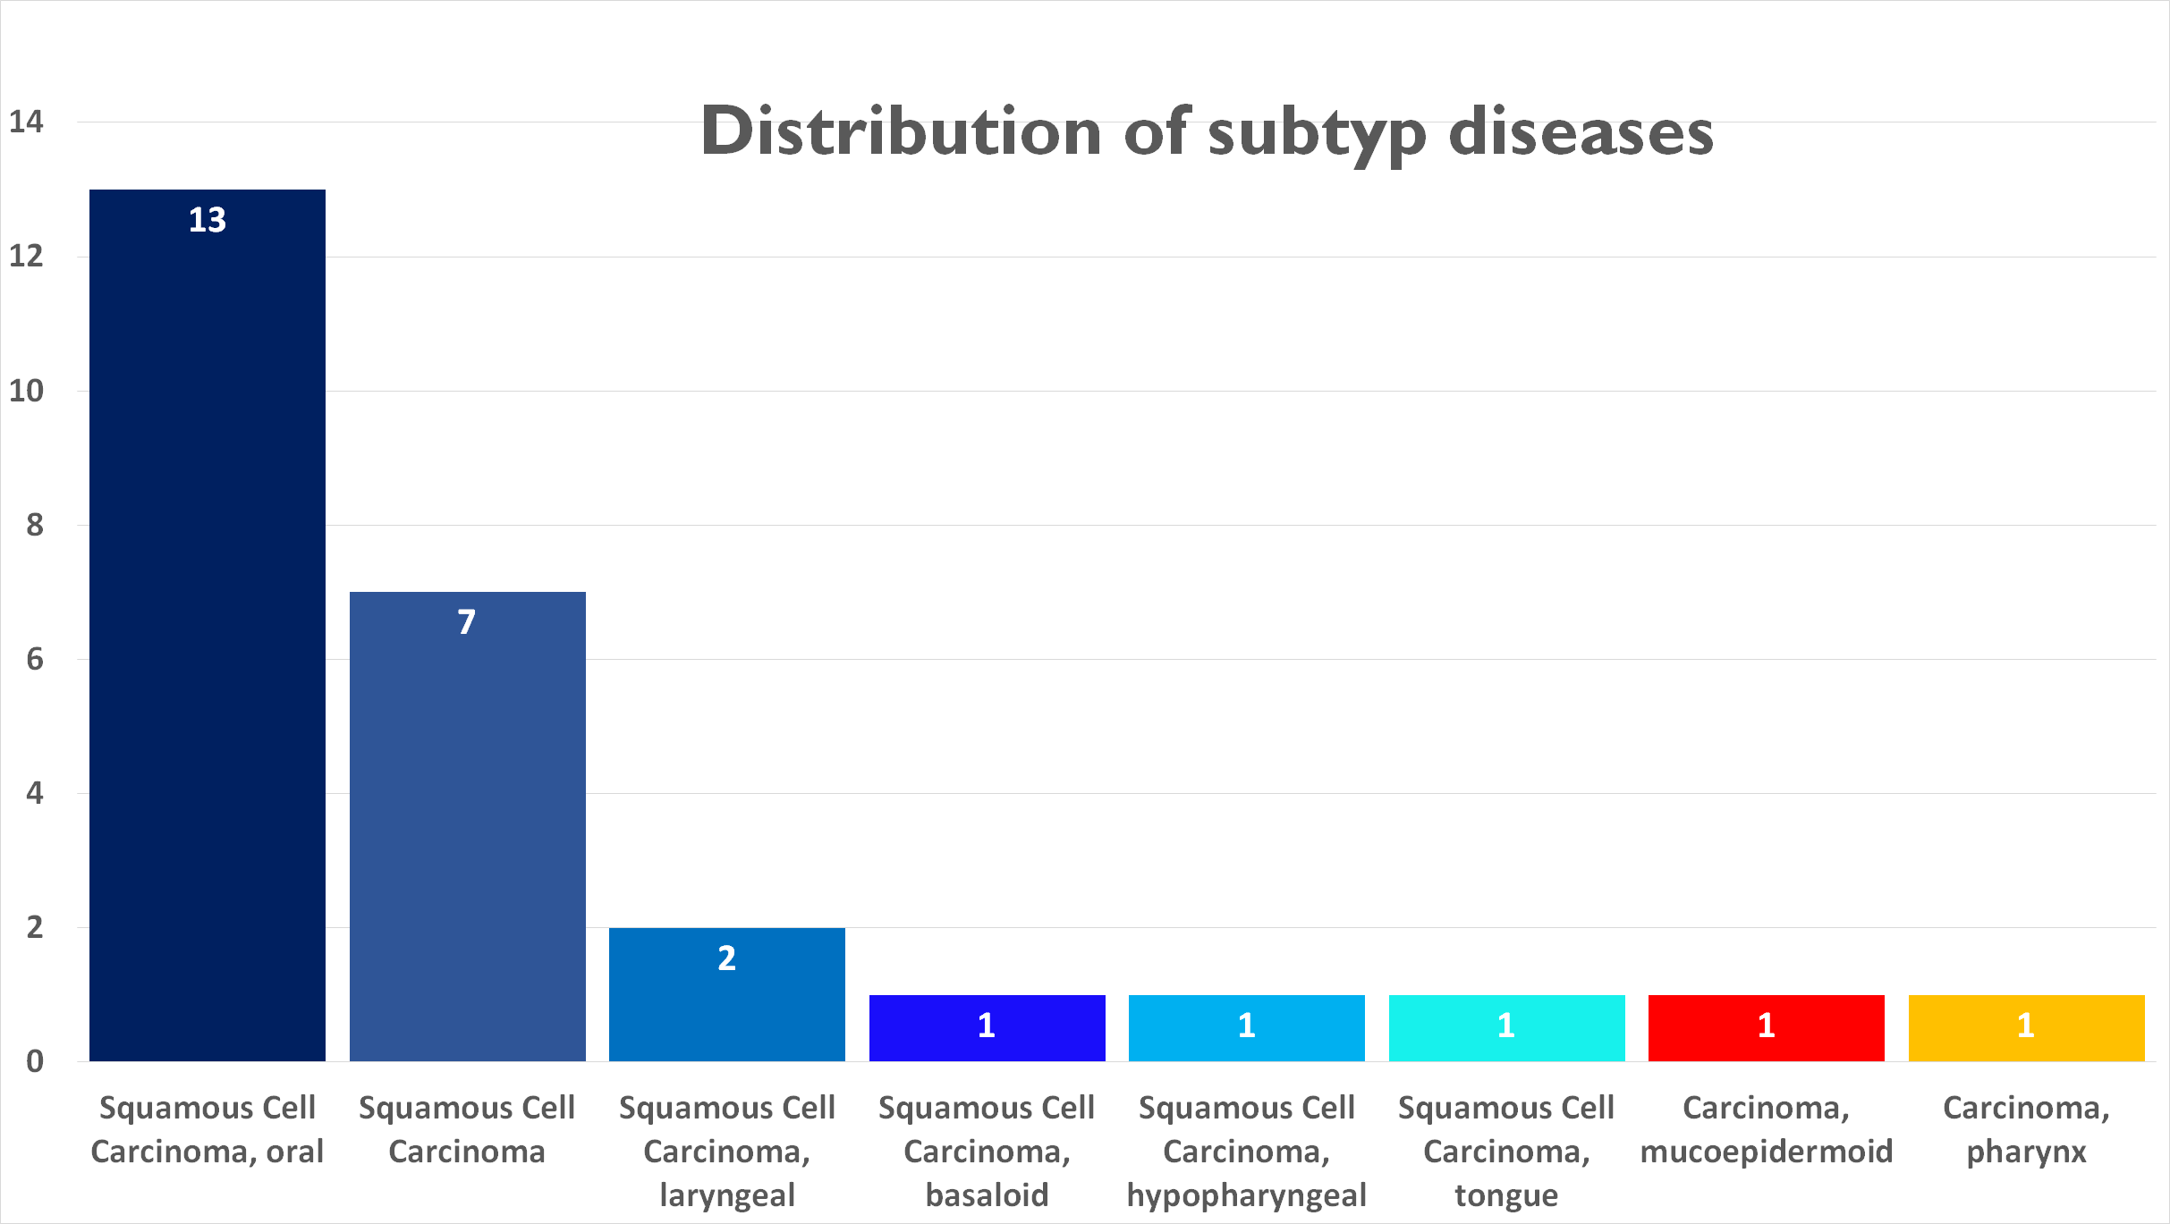
Characteristics about HNC
https://speciality.medicaldialogues.in/hepatitis-c-ups-risk-of-head-and-neck-cancers/

Slide 3
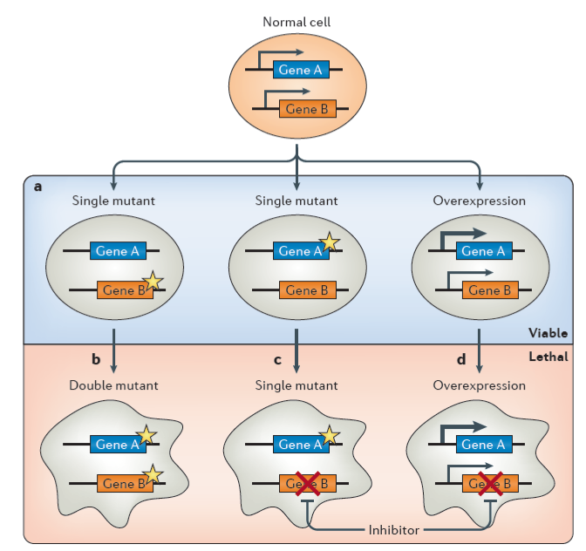
Synthetic lethality (SL) / Synthetic dosage lethality (SDL)
SL
SL
SDL
O’Neil, Nigel J., Melanie L. Bailey, and Philip Hieter. “Synthetic lethality and cancer.” Nature Reviews Genetics 18.10 (2017): 613.

Slide 4
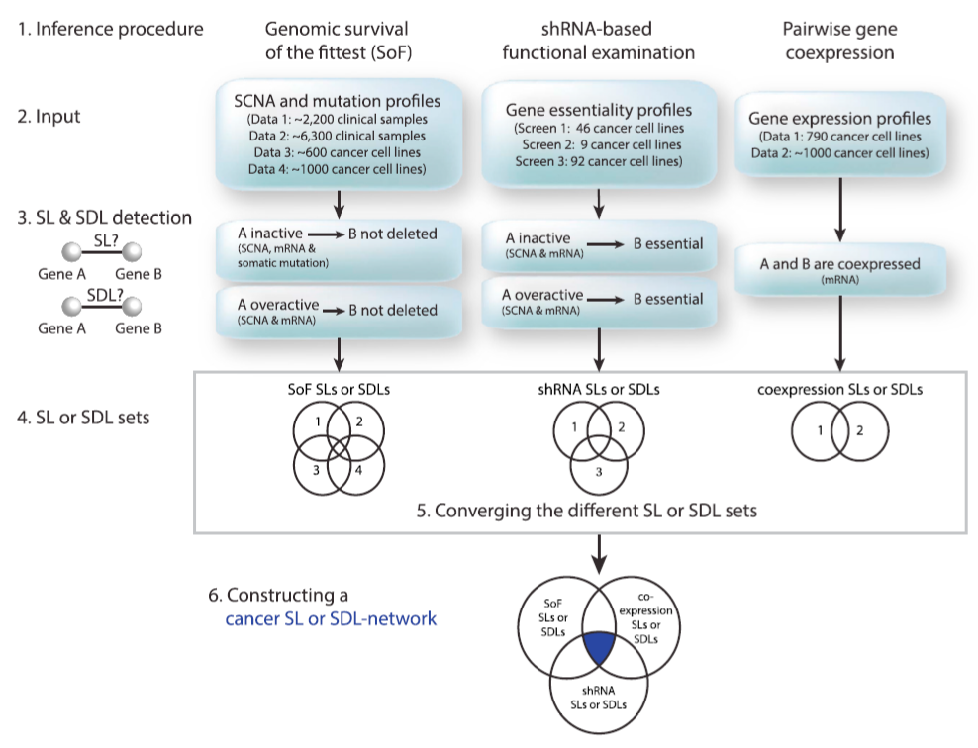
DAISY
Jerby-Arnon, Livnat, et al. “Predicting cancer-specific vulnerability via data-driven detection of synthetic lethality.” Cell 158.5 (2014): 1199-120.

Slide 5






DepMapData
Gene expression
Copy number alteration
Mutation
CERES knockdown
Kockdown probability
Annotation
Notes:
ID, Primary Disease, Secondary Desease

Slide 6
Milestones
Data Cleanup & Descriptive Statistics
Identify gens of interest
Find SL/SDL partner
Mutation Prediction
Calendar week 22
Calendar week 24
Calendar week 26
Calendar week 28
Gene expression
Copy number alteration
Mutation
CERES knockdown
Annotation

Slide 7
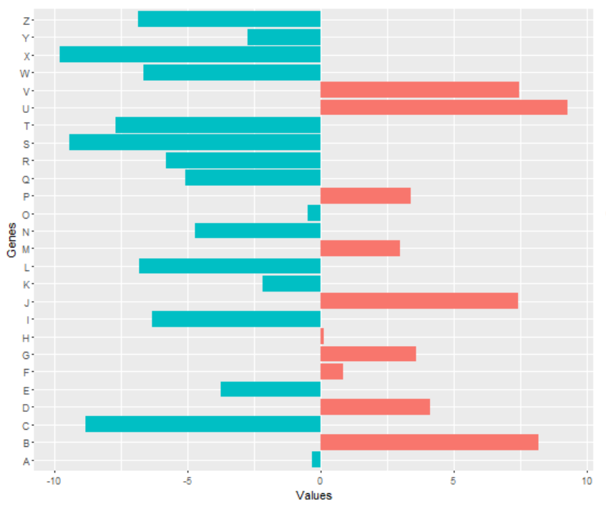
Data Cleanup & Descriptive Statistics
Identify gens of interest
Find SL/SDL partner
Mutation Prediction
Filtering information concerning wanted objects (-ID, Disease, NA)
Investigate frequencies, expression data and essentiality
Plotting interessting data
Compact data overwiev
https://stackoverflow.com/questions/37753485/rotating-ggplot2-double-sided-barplot

Slide 8
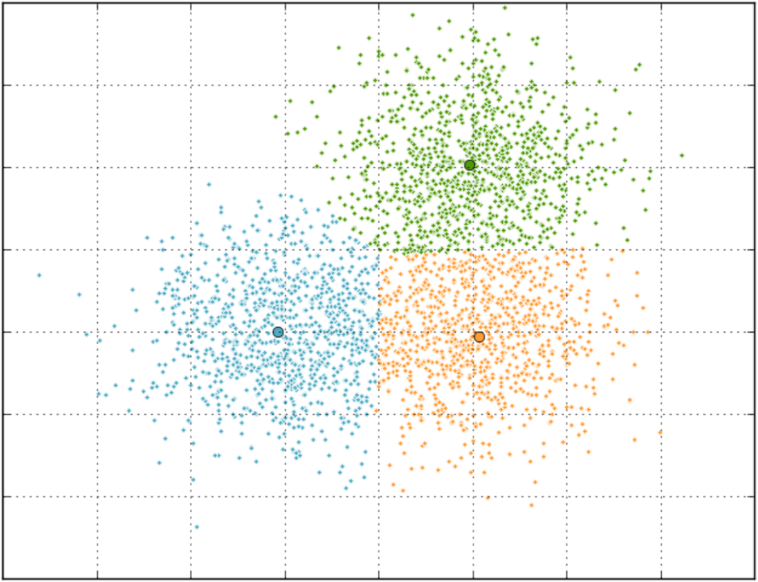
Data Cleanup & Descriptive Statistics
Identify gens of interest
Find SL/SDL partner
Mutation Prediction
Dimensional reduction: plotting CNA and overexpression
k-means
Investigate high frequencies of deleterious mutations
CNA
Expression

Slide 9
Data Cleanup & Descriptive Statistics
Identify gens of interest
Find SL/SDL partner
Mutation Prediction
Survival of the fittest
H0: no significant CNA level difference of gene B while gen A is inactive/overactive
Functional examination
H0: no significant difference in knockdown levels of gene B while gene A is inactive/overactive
Gen coexpression
correlation between expression data of two gens
Notes:
Wilcoxon Rank sum test

Slide 10
Data Cleanup & Descriptive Statistics
Identify gens of interest
Find SL/SDL partner
Mutation Prediction
Multiple Linaere Regression
Examine correlation between variables
Variance decomposition
F-test
T-test of each variable
Compare different models
Notes:
Pairwise scatter plot für correlation der variablen

